Slide 1



Cryptography
Variability Expedition

Slide 2
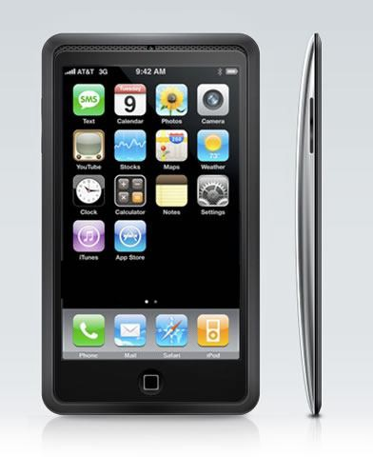



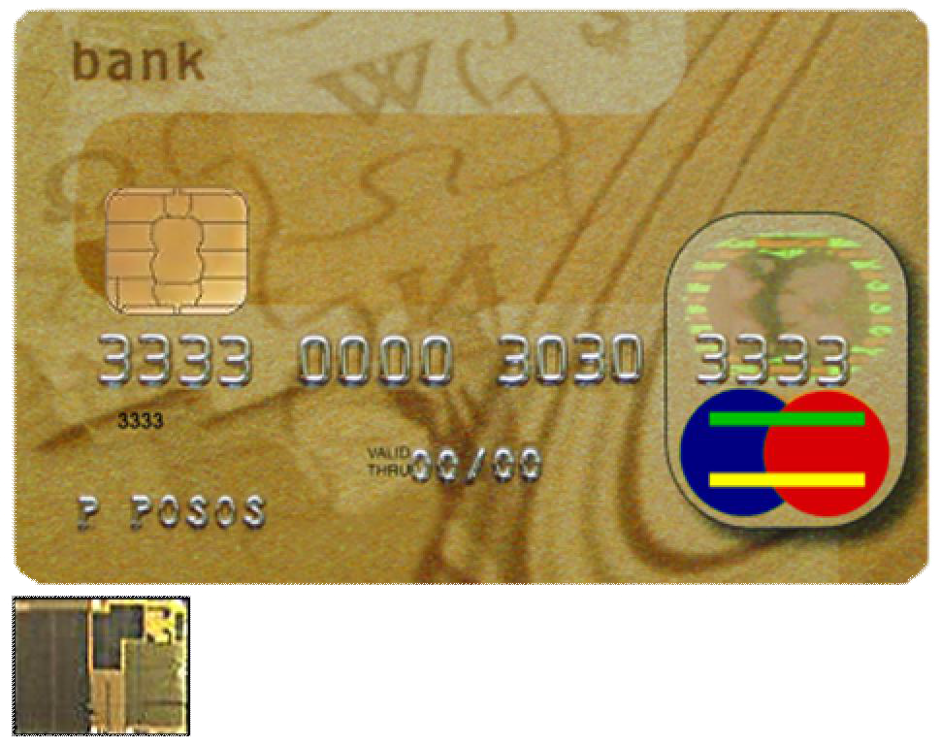


How does Cryptography affect you?
www.variability.org

Slide 3


Security Services
Confidentiality: Information is kept secret
Integrity: Messages have not been modified
Authenticity: The sender of a message is authentic
Nonrepudiation: The sender of the message cannot deny the creation of the message
www.variability.org

Slide 4
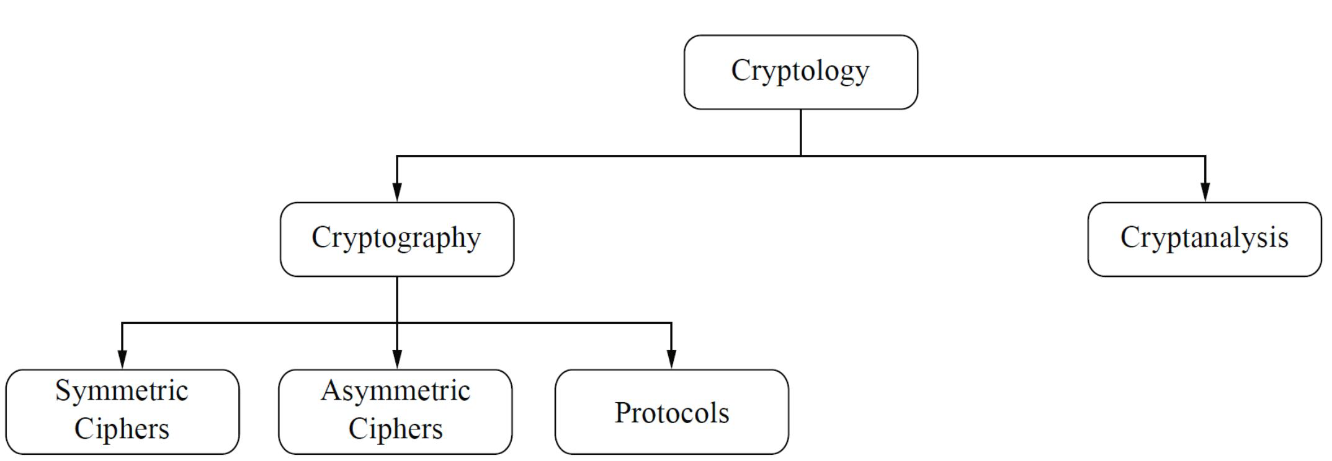


Classifications
Information hiding
attacking
A shared secret key
Public Key Infrastructure
Applications
www.variability.org

Slide 5
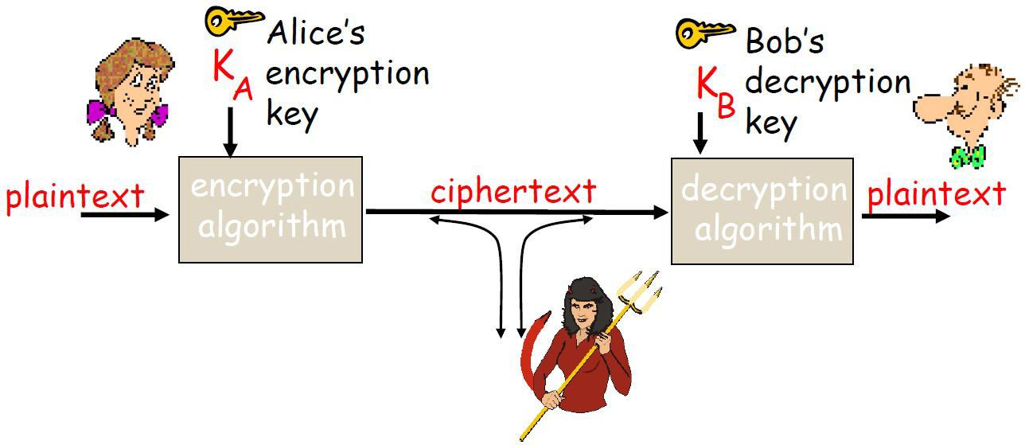


Symmetric Ciphers
A secret message
A secret message
#d%2d!4#@wa
www.variability.org

Slide 6


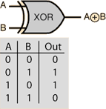



Example 1: One Time Pad
XOR operation
Plaintext: 100101
+
Key: 001101
Ciphertext: 101000
100101
=
001101
+ 101000
=
Insecure channel
Perfect confidentiality! (What about integrity and authenticity?)
Key length = plaintext length (cannot reuse the key)
Why XOR but not AND gate or OR gate?
www.variability.org

Slide 7
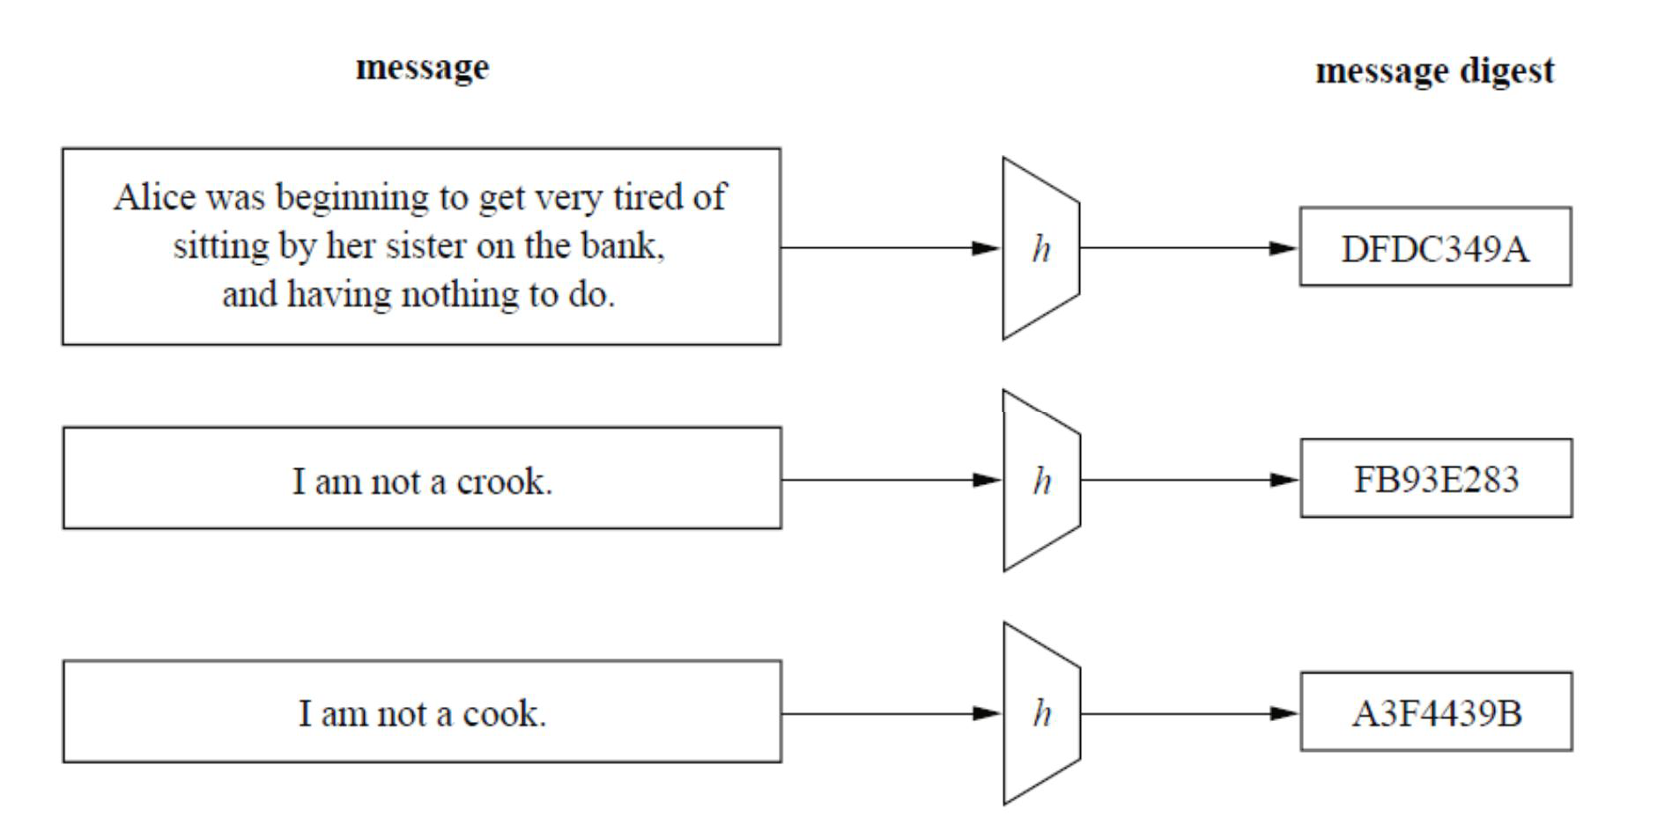


Example 2: Hash Function
A Hash function is an important cryptographic primitive because
It produces the fingerprint (digest) of a message
Arbitrary input length, fixed output length (md5sum)
Difficult to calculate message back from its fingerprint
www.variability.org

Slide 8
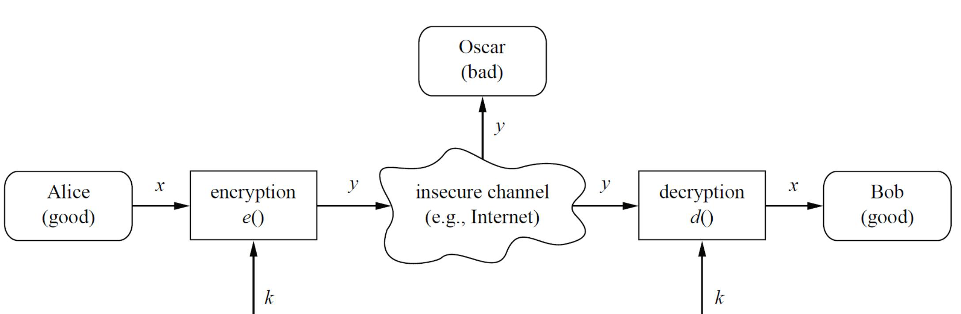


Is Symmetric Cipher Good Enough?
What are potential limitations of this system?
Key distribution
What if Alice/Bob tries to cheat? (Nonrepudiation)
www.variability.org

Slide 9
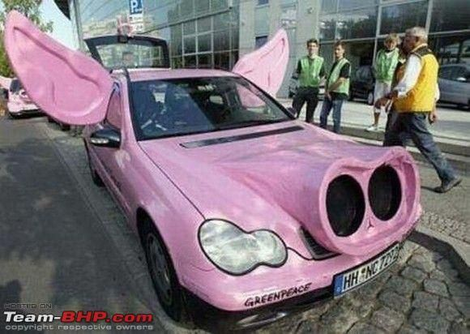


No Nonrepudiation in Symmetric Ciphers
Nonrepudiation: The sender of the message cannot deny the creation of the message
Bob wants to buy a car from Alice (they have a shared key)
Bob signs the contract, encrypts and sends it to Alice
Alice decrypts the ciphertext and receives the contract. Everyone is happy for now.
Bob’s wife sees the car and does not like the car at all because it is just too ugly.
Bob now claims that he never ordered the car.
If you were Alice’s lawyer, what would you do? If you were Bob’s lawyer, what would you do?
www.variability.org

Slide 10

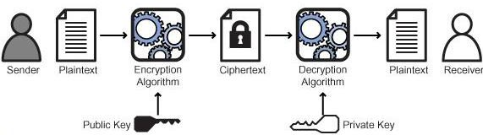
Asymmetric Ciphers
Introduced in 1976
Key = (Public Key, Private Key)
Everyone can encrypt a plaintext, but only one can decrypt the ciphertext
sender
Plaintext
Encryption
Ciphertext
Decryption
Plaintext
receiver
Public key
Private key
www.variability.org

Slide 11
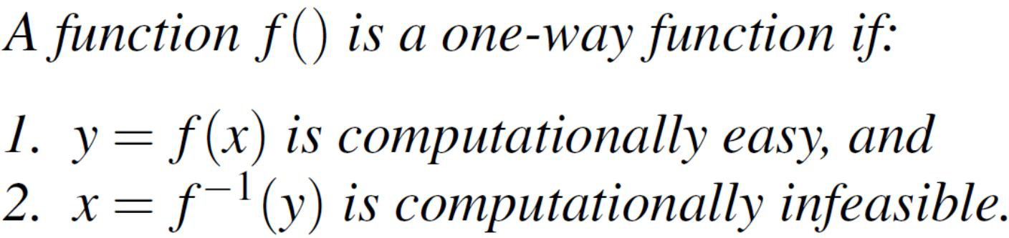
One-Way Function
One-Way Function (OWF)
Question:
Is f(x)=2x+3=y a OWF?
No. f⁻¹(y)=(y-3)/2=x is easy to compute.
The Factorization Problem is a OWF
It is “easy” to compute the product of two large primes, but “difficult” to factor the product (example: RSA algorithm)
Hash Function is a OWF
www.variability.org

Slide 12
Exercise 1: The Factorization Problem
Try to find the prime factors of these numbers. How long does it take to find the answer? You may want to use xrange() for large loops
247
13 and 19
31,861
151 and 211
1,342,643
17 and 78,979
13,483,733
3,109 and 4,337
24,315,751
This is a prime number
376,835,043,318,661
15,497,539 and 24,315,799
www.variability.org

Slide 13

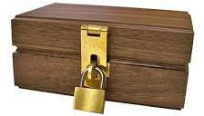


OWF Is Important in Cryptography
OWF:
Unless you have the private key!!
Asymmetric ciphers are built on OWFs
deposit
unlock
How can two parties exchange a symmetric key using asymmetric key algorithm?
www.variability.org

Slide 14


Example 1: Key exchange Using Asymmetric Cipher
Alice knows the Public key (she can compute f(x) easily)
Bob knows the Private key (he can compute f⁻¹(y) easily)
They can exchange a private key for a symmetric cipher by:
Alice creates a random key for symmetric cipher
Alice encrypts the key using the Public key and sends the ciphertext to Bob
Only Bob can decrypt the ciphertext with his Private key
Fpublic_key(key)
key
F⁻¹private_key(Fpublic_key(key))
= key
Asymmetric cipher is much slower than symmetric cipher!
www.variability.org

Slide 15






Example 2: Digital Signature
Going back to the car-buying example.
To provide nonrepudiation, Bob is required to sign the contract with his Private key and a hash function Hash(x)!
Contract, S
Public key
Private key
Z=Hash(Contract) ^{Z’=F}public_key^{(S)}
Z=Hash(Contract) ^{S=F}private_key^{(Z)}
Confidentiality? No. Integrity? Yes.
Authenticity? Yes.
Verify if Z==Z’
www.variability.org

Slide 16
Protocols
Cryptographic protocols deals with the application of cryptographic algorithms
2 or more parties
Has a specific purpose
Precisely defined sequence of steps
Some “secrets” are involved
Symmetric and Asymmetric algorithms are used as building blocks in protocols
www.variability.org

Slide 17

Coin Flipping Protocol
Alice and Bob want to toss a coin over the phone!
“My son will toss the coin, you call it!”
“Tails”
“Sorry, it was heads!”
Is this a good protocol?
www.variability.org

Slide 18


A better Coin Flipping Protocol
1. Flips a bit r₀ and locks the result in a box
3. After receiving the box, Bob flips a bit r₁ in the open and sends to Alice
2. Sends the box to Bob
r₁
4. After receiving r₁, Alice sends the key of the box to Bob
Now both Alice and Bob know r₀ and r₁ The results of the coin flip is r₀ + r₁
www.variability.org

Slide 19
Diffie-Hellman Key Exchange
Alice and Bob want to establish a shared secret key. No one has a Private key at the beginning! A public integer K is known to Alice and Bob.
_{K}a
1. Choose a random integer a
1. Choose a random integer b
_{K}b
2. Compute Kª
2. Compute K^{b}
3. Sends to Kª Bob
3. Sends to K^{b} Alice
4. The secret key=(K^{b})ª =(Kª)^{b}
4. The secret key=(Kª)^{b}= (K^{b})ª
www.variability.org

Slide 20
Before Getting rid of Alice and Bob
In cryptography, how do you make sure your algorithm is secure?
Should the algorithms be publicly released?
Kerckhoff’s Principle (1883):
A crypto system should be secure even if the attacker knows all details about the system, with the exception of the secret keys. In particular, the system should be secure when the attackers knows the encryption and decryption algorithms.
www.variability.org

Slide 21
It’s time to see how the first cipher was created by a guy much more famous than Alice and Bob!
www.variability.org

Slide 22
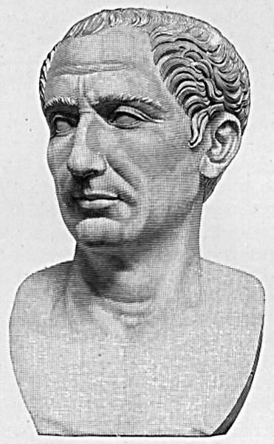
Caesar Cipher
Julius Caesar (100 BC – 44 BC) was an emperor of Rome
Wants to send his hand written commands to his distant armies by courier
The message can be intercepted by enemy forces any minute
What can he do?
Julius Caesar
Source: H. F. Helmolt: History of the World. New York, 1902
www.variability.org

Slide 23
Caesar Cipher
He came up with a scheme to disguise his messages as gibberish
Any guesses?
Julius Caesar
Source: H. F. Helmolt: History of the World. New York, 1902
www.variability.org

Slide 24
Caesar Cipher
Caesar was actually commanding:
Attack at once
But the intercepted message read:
Can you see how this is done?
This is the first appearance of cryptography
Julius Caesar
Source: H. F. Helmolt: History of the World. New York, 1902
www.variability.org

Slide 25
Caesar Cipher
Attack at once
If he had anything confidential to say, he wrote it in cipher, that is, by so changing the order of the letters of the alphabet, that not a word could be made out. If anyone wishes to decipher these, and get at their meaning, he must substitute the fourth letter of the alphabet, namely D, for A, and so with the others.
—Suetonius, Life of Julius Caesar
Julius Caesar
Source: H. F. Helmolt: History of the World. New York, 1902
www.variability.org

Slide 26
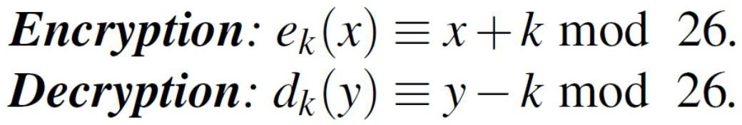
Modulo Operation
The modulo operation finds the remainder after division of a ^{nu}13^{m}=^{b}(^{e}2^{r}× 5) + 3 ≡ 3 mod 5
13 + 1 =14 ≡ (3+1) ≡ 4 mod 5
6 × 8 = 48 ≡ 3 mod 9 a × a⁻¹ ≡ 1 mod m
If a=3, m=26, what is a⁻¹ ?
9, because 3 × 9 = 27 ≡ 1 mod 26
Caesar Cipher
www.variability.org

Slide 27


Going back to Caesar Cipher
Let’s encrypt Caesar’s order for him!
Attack at once
Shift each letter by 3
Plaintext | Ciphertext
A | D
T | W
C | F
K | N
O | R
www.variability.org

Slide 28


Exercise 2:
What is the Caesar Cipher for the following plaintext input? Use left shift of 4 (A → E, B → F, and so on)
Plaintext: WE ARE OUT OF SUPPLIES
Ciphertext:
Try deciphering this code
Ciphertext: HPPE KPC
Plaintext:
www.variability.org

Slide 29


Exercise 2(Solution):
What is the Caesar Cipher for the following plaintext input? Use left shift of 4 (A → E, B → F, and so on)
Plaintext: WE ARE OUT OF SUPPLIES
Ciphertext: AI EVI SYX SJ WYTTPMIW
Try deciphering this code
Ciphertext: HPPE KPC
Plaintext: GOOD JOB
www.variability.org

Slide 30


Brute Force Decryption: Caesar Cipher
Ciphertext: Fyyfhpfytshj
If the alphabet is shifted by 1:
Exxegoexsrgi
If shift = 2:
Dwwdfndwrqfh
www.variability.org

Slide 31


Brute Force Decryption: Caesar Cipher
Continue trying out each shift...
Decryption shift | Candidate plaintext
1 | exxegoexsrgi
2 | dwwdfndwrqfh
3 | cvvcemcvqpeg
4 | buubdlbupodf
5 | attackatonce
6 | zsszbjzsnmbd
…
When shift is 5, the sentence makes sense!
Key space is small, so brute force may be a good approach
www.variability.org

Slide 32
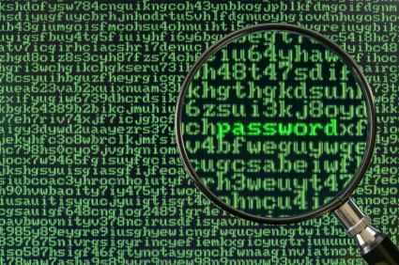


Smarter Decryption: Frequency Analysis
Brute force checking can theoretically crack almost any cipher
Notice that in the Caesar Cipher, letters are directly mapped
Any patterns of English speech should also be visible in the ciphertext!
Frequency analysis: certain letters and combinations of letters occur with certain frequencies
This involves a lot of statistics and computers are good at such work!
www.variability.org

Slide 33


Frequency Analysis
What are the only possible single letter words in English?
Answer:
What are the most common double letter combinations in English?
Answer:
www.variability.org

Slide 34
Frequency Analysis
What are the only possible single letter words in English?
Answer: A and I
What are the most common double letter combinations in English?
Answer: “mm”, “oo”, “ee”, “tt”, and so on…
You should be seeing patterns that could be exploited to crack a substitution cipher!
Side Channel attack!
www.variability.org

Slide 35
Exercise 3a: Frequency Analysis
Count the number and frequencies of ‘a’, ‘e’, ‘i’, ‘o’, ‘v’, ‘x’, ‘z’ in the following text:
Under the terms of a special appropriation made by the State Legislature in the Spring of 1943, a College of Engineering was established at UCLA in November of 1944. L.M.K. Boelter, the Associate Dean of Engineering at UC Berkeley, was invited to come to Los Angeles and be the founding Dean of the new College.
www.variability.org

Slide 36
Exercise 3a: Frequency Analysis (Solution)
‘a’: 20
‘e’: 41
‘i’: 17
‘o’: 18
‘v’: 2
‘x’: 0
‘z’: 0
With 256 characters in the previous paragraph the frequencies are
‘a’: 7.8%
‘e’: 16.0%
‘i’: 6.6%
‘o’: 7.0%
‘v’: 0.8%
‘x’: 0.0%
‘z’: 0.0%
www.variability.org

Slide 37


Exercise 3b: Frequency Analysis
Count the number and frequencies of ‘a’, ‘e’, ‘i’, ‘o’, ‘v’, ‘x’, ‘z’ in the following text:
She hoisted a box wrapped in brown paper on to the table; it had clearly been unwrapped and carelessly re-wrapped. There was a scribbled note across it in red ink, reading: Inspected and Passed by the Hogwarts High Inquisitor.
www.variability.org

Slide 38
Exercise 3b: Frequency Analysis (Solution)
‘a’: 17
‘e’: 25
‘i’: 13
‘o’: 9
‘v’: 0
‘x’: 1
‘z’: 0
With 118 characters in the previous paragraph the frequencies are
‘a’: 9.4%
‘e’: 13.3%
‘i’: 6.9%
‘o’: 4.8%
‘v’: 0.0%
‘x’: 0.5%
‘z’: 0.0%
www.variability.org

Slide 39
Exercise 3ab discussion
Compare the frequency statistic of the previous two exercises
Notice how this pattern could be used?
Exercise 1:
‘a’: 7.8%
‘e’: 16.0%
‘i’: 6.6%
‘o’: 7.0%
‘v’: 0.8%
‘x’: 0.0%
‘z’: 0.0%
Exercise 2:
‘a’: 9.4%
‘e’: 13.3%
‘i’: 6.9%
‘o’: 4.8%
‘v’: 0.0%
‘x’: 0.5%
‘z’: 0.0%
www.variability.org

Slide 40
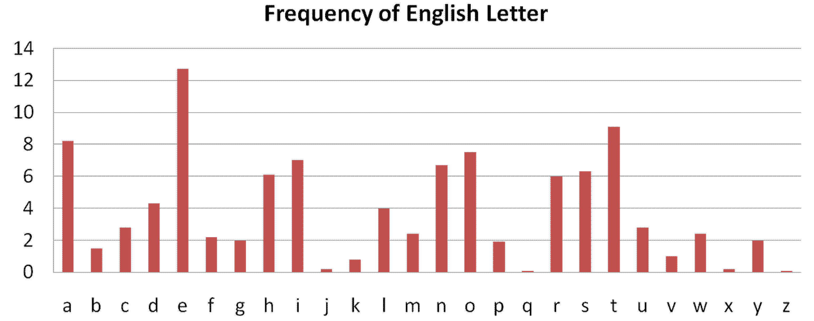
Frequency Analysis: English
The standard frequency of characters in English text is as below (%):
www.variability.org

Slide 41
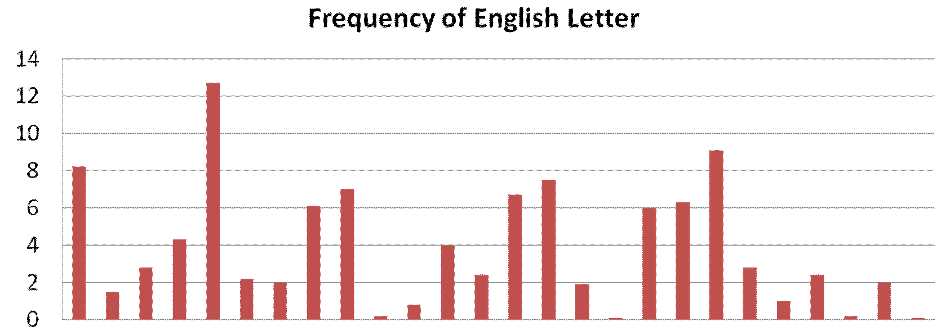
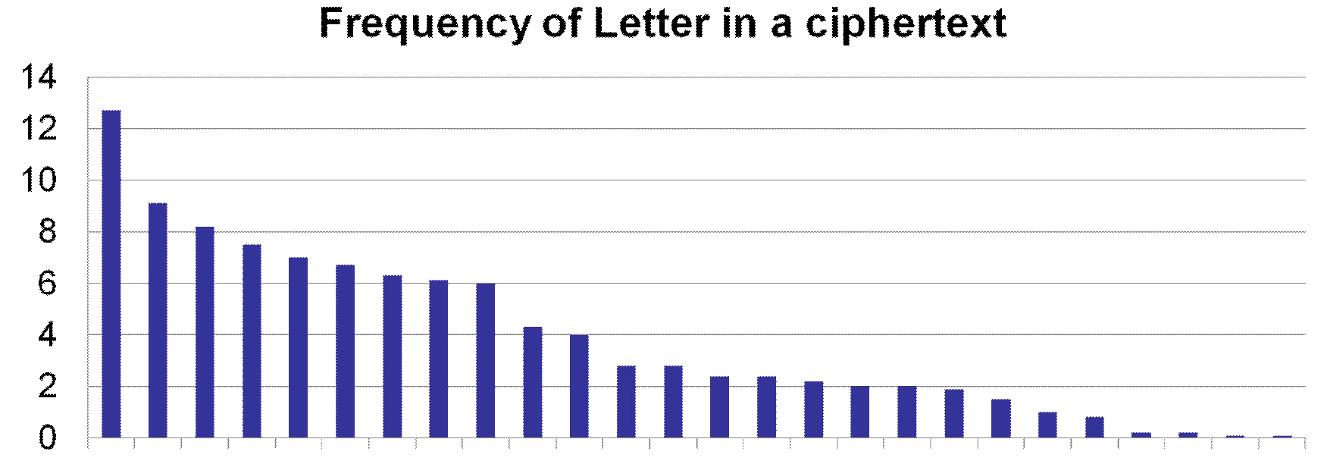
Frequency Analysis: English
If we sort the frequency chart
www.variability.org

